Slide 1
Emotional Intelligence (EI)

Slide 2

Emotional Intelligence (EI)
The term was coined by two researchers – Peter Salovey and John Mayer in 1990 but got popular in 1996 from Dan Goleman’s book ‘Emotional Intelligence: Why It Can Matter More Than IQ’.
Emotional intelligence refers to ‘the ability to identify one’s own emotions and those of others, harness and apply them to tasks, and to regulate and manage them’.
Emotional Quotient (EQ) is a measure of one’s EI i.e. through a standardized test, one’s awareness of emotions in relation to self and others is known.

Slide 3
Elements of EI (as given by Daniel Goleman)
Self-Awareness: It is the skill of being aware of and understanding one’s emotions as they occur and as they evolve.
Self-Regulation: It is about controlling one’s emotions i.e. instead of reacting quickly; one can reign in one’s emotions and thus will think before responding.
Internal Motivation: It includes one’s personal drive to improve and achieve commitment to one’s goals, initiative, or readiness to act on opportunities, and optimism and resilience.
Empathy: It is an awareness of the needs and feelings of others both individually and in groups, and being able to see things from the point of view of others.
Social Skills: It is applying empathy and balancing the wants and requirements of others with one’s. It includes building good rapport with others.

Slide 4
Importance of EI
For Targeting Policies better
For motivating subordinates
Stress Management: EI enables one to manage emotions in anxiety-provoking situations and thus helps one in maintaining one’s physical and mental well being.
For change: An Emotionally Intelligent person is more likely to try new things, take risks and face new challenges without fear.
For Decision making
For Better Communication
For maintaining balance in life: EI helps a employees in managing his/her personal life as well as professional life.

Slide 5
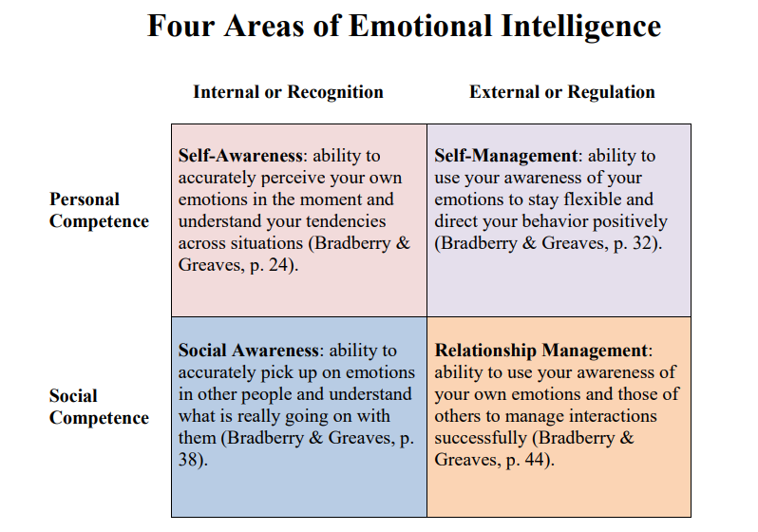

Slide 6
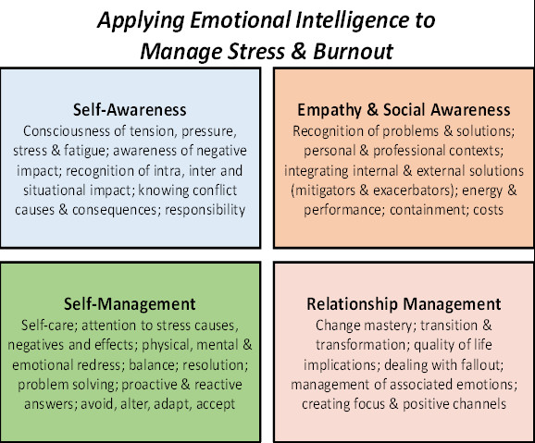

Slide 7
EQ Measurement
https://www.youtube.com/watch?v=Y7m9eNoB3NU
Dan Goleman’s book ‘Emotional Intelligence: Why It Can Matter More Than IQ’. SUMMARY:
https://www.youtube.com/watch?v=n6MRsGwyMuQ

Slide 8

THANK YOU

